Slide 1

Exploratory Data Analysis
Retail Forecasting Case
Apr-29-2024
Yan-Ping Yu

Slide 2

Agenda
Executive Summary
Problem Statement
EDA
EDA Summary
Recommendations

Slide 3
Executive Summary
The large company that is into the beverages business in Australia. They sell their products through various super-markets and also engage in heavy promotions throughout the year. Their demand is also influenced by various factors like holiday, seasonality. They needed forecast of each of products at item level every week in weekly buckets.
This initiative is driven by the need to analyze historical time series data, incorporating various factors that influence demand, to forecast the quantity of items required by customers each week.

Slide 4
Problem of Statement
The primary challenge is to develop multivariate forecasting models, utilizing machine learning or deep learning techniques, to accurately predict weekly demand for their products.

Slide 5
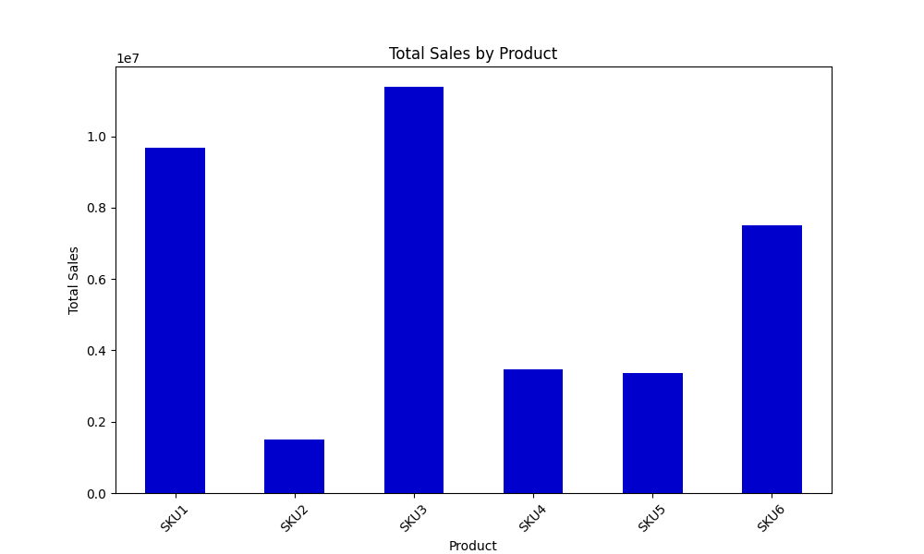
Total Sales of Product Analysis
Top-Performing Products:
SKU3
SKU1
SKU6
Customer preference concentrated on specific products
SKU3, SKU1, and SKU6 might be more aligned with market trends

Slide 6
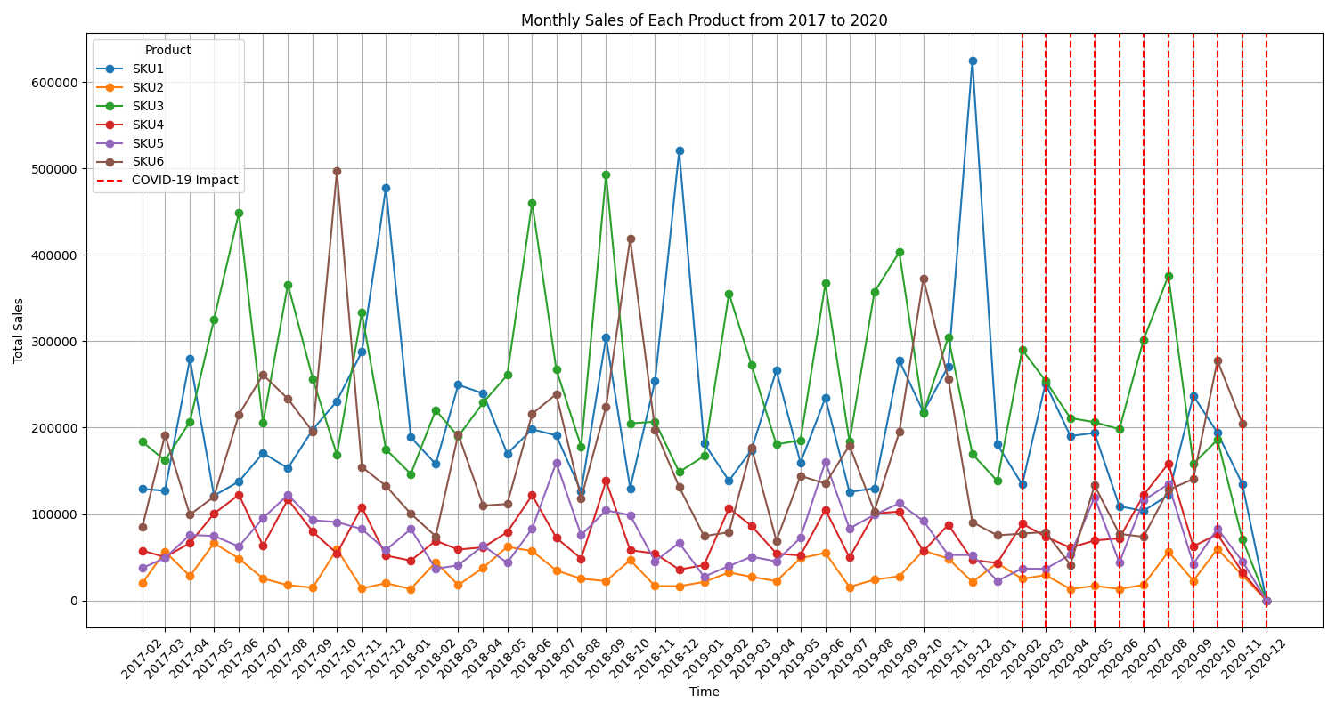
Sales of Products Over Years Analysis
COVID-19 had a significantly
negative impact on sales, especially on
two highest total sales products,
SKU1 and SKU6
Pandemic might have led to changes in consumer spending
SKU1 and SKU6 may be more sensitive to market changes and external disruptions

Slide 7
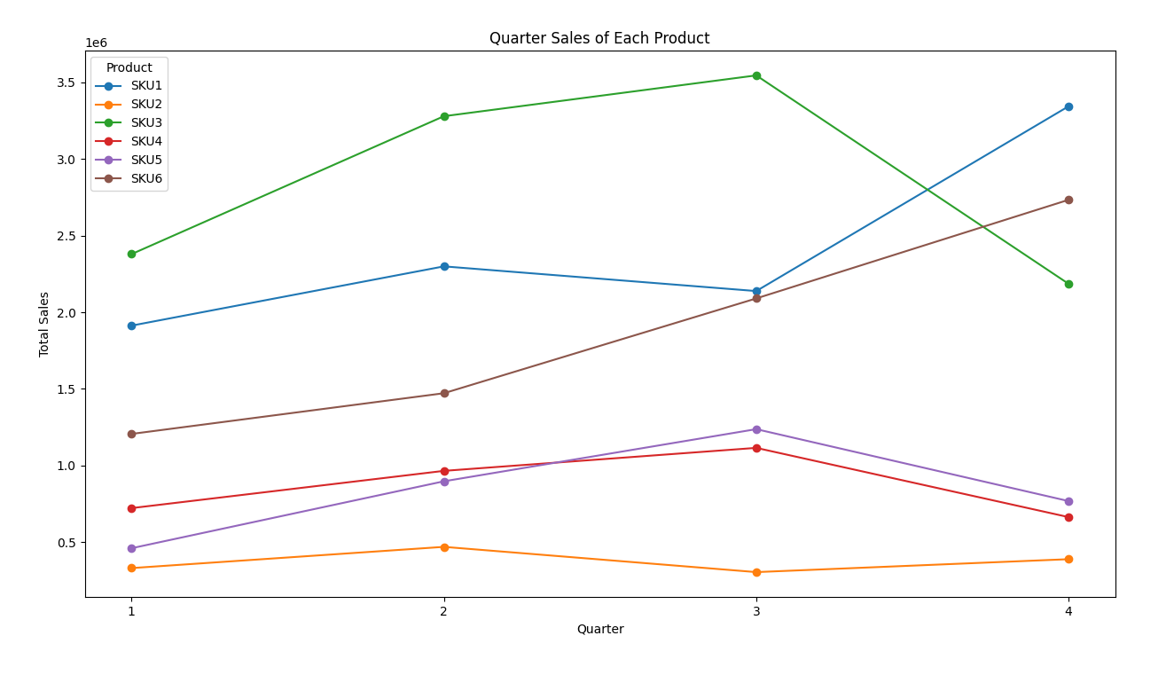
Quarter Sales Analysis
Each Product has its own
Seasonality Patterns in Sales:
Peak Performance:
SKU1: Q4
SKU2: Q2
SKU3: Q3
SKU4: Q3
SKU5: Q3
SKU6: Q4

Slide 8
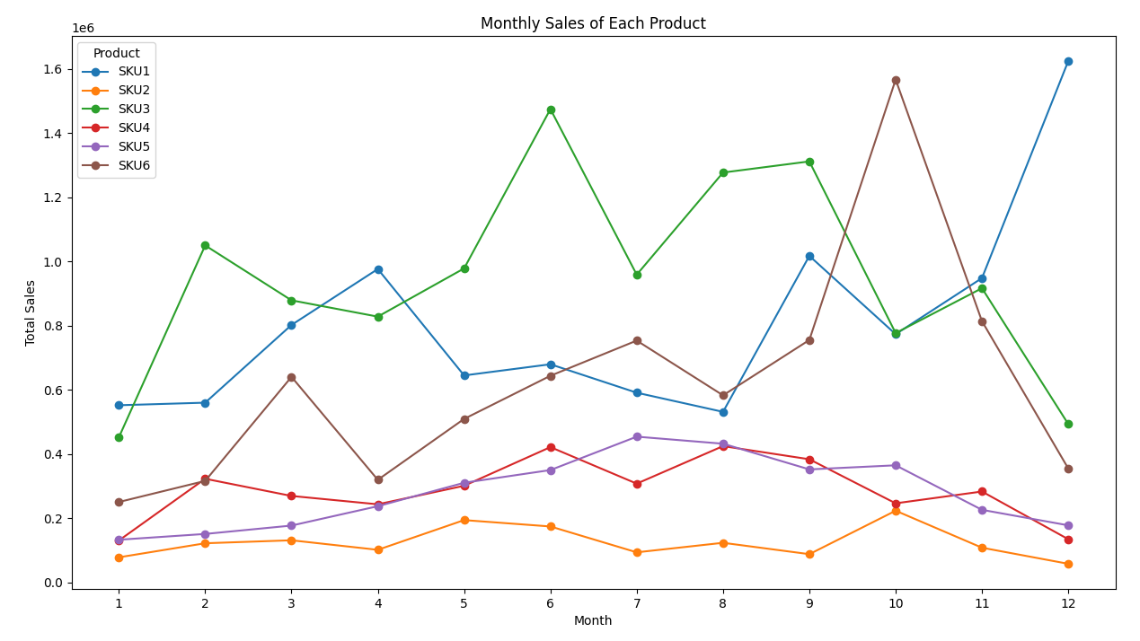
Monthly Sales Analysis
Each Product has its own
Seasonality Patterns in Sales:
Peak Performance:
SKU1: Dec
SKU2: Oct
SKU3: Jun
SKU4: Jun
SKU5: Jul
SKU6: Oct

Slide 9
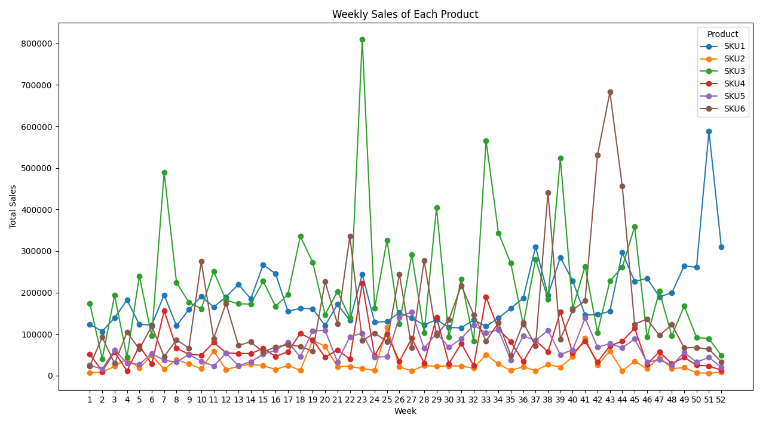
Weekly Sales Analysis
Each Product has its own
Seasonality Patterns in Sales:
Peak Performance for Week:
SKU1: 51st
SKU2: 25th
SKU3: 23rd
SKU4: 23rd
SKU5: 27th
SKU6: 43rd

Slide 10
If sales indicate seasonality, we can…
Predict Sales Pattern
Improve Inventory Management
E.g. prompting the company to stock up ahead of anticipated sales increases and manage stock more conservatively during slower periods
3. Design Marketing & Promotions Plan
E.g. Marketing efforts can be timed to coincide with seasonal peaks to maximize their impact. Promotional activities could be planned to boost sales during typically slow periods.

Slide 11
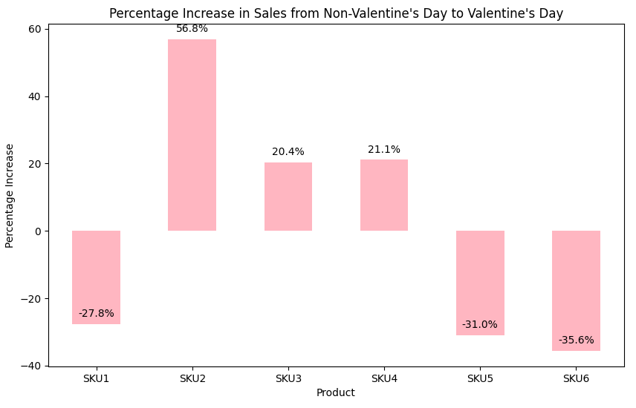
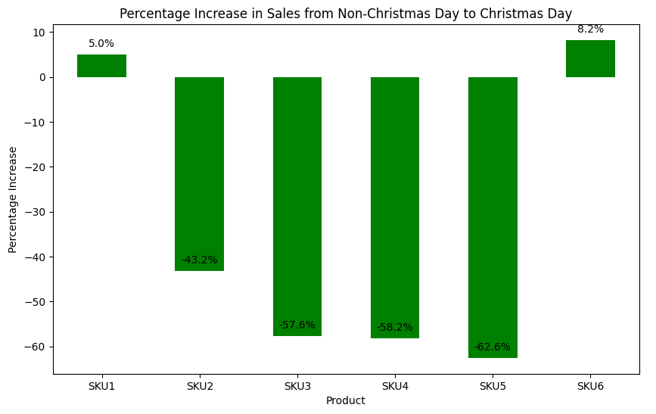
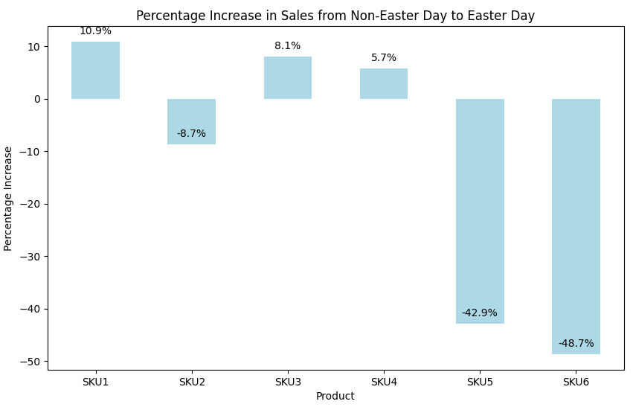
Sales in Non-holiday v.s. Holiday
1. SKU2 sales increase the most during Valentine’s Day.
2. SKU6 sales decrease the most during Easter Day.
3. Most product sales decrease significantly during Christmas.
A sales increase/decrease during holidays can inform inventory & marketing decisions
 | Sales in Valentine’s | Sales in Easter | Sales in Christmas
SKU1 | Decrease | Increase | Increase
SKU2 | Increase | Decrease | Decrease
SKU3 | Increase | Increase | Decrease
SKU4 | Increase | Increase | Decrease
SKU5 | Decrease | Decrease | Decrease
SKU6 | Decrease | Decrease | Increase

Slide 12
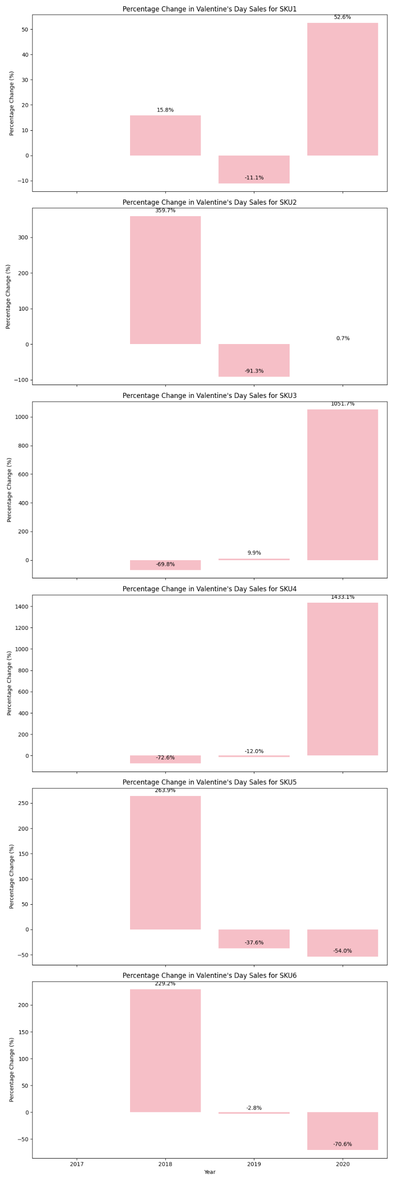
Yearly Sales Change in Valentine’s Day
 | Yearly Sales Trend
SKU1 | Increase
SKU2 | Decrease
SKU3 | Increase
SKU4 | Increase
SKU5 | Decrease
SKU6 | Decrease
SKU1, SKU3, and SKU4 seem to align more closely with customer preferences these days and also demonstrate resilience during the COVID-19 period

Slide 13
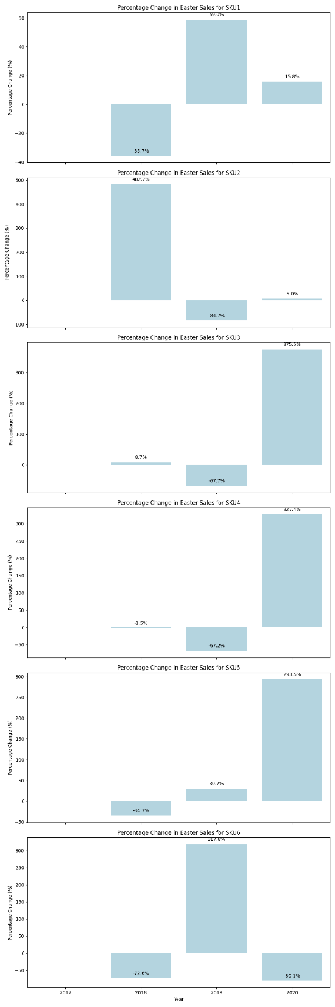
Yearly Sales Change in Easter Day
 | Yearly Sales Trend
SKU1 | Increase
SKU2 | Decrease
SKU3 | Increase
SKU4 | Increase
SKU5 | Increase
SKU6 | Fluctuate
SKU3, SKU4, and SKU5 show high sales during COVID-19 period, indicating these products might be considered essential or high-need items during the pandemic

Slide 14
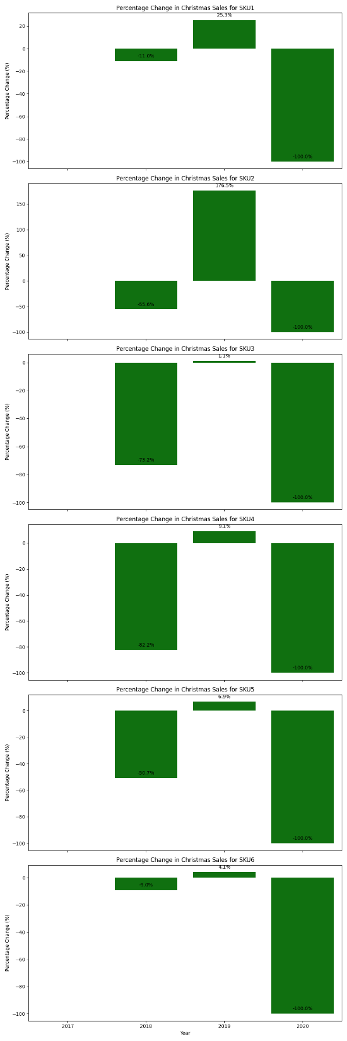
Yearly Sales Change in Christmas Day
 | Yearly Sales Trend from 2018 to 2019 | Yearly Sales Trend considered 2020 COVID-19 period
SKU1 | Increase | Decrease
SKU2 | Increase | Decrease
SKU3 | Increase | Decrease
SKU4 | Increase | Decrease
SKU5 | Increase | Decrease
SKU6 | Increase | Decrease
The sales for all products on Christmas day were completely influenced by COVID-19. Our client’s physical stores might shut down during this time

Slide 15
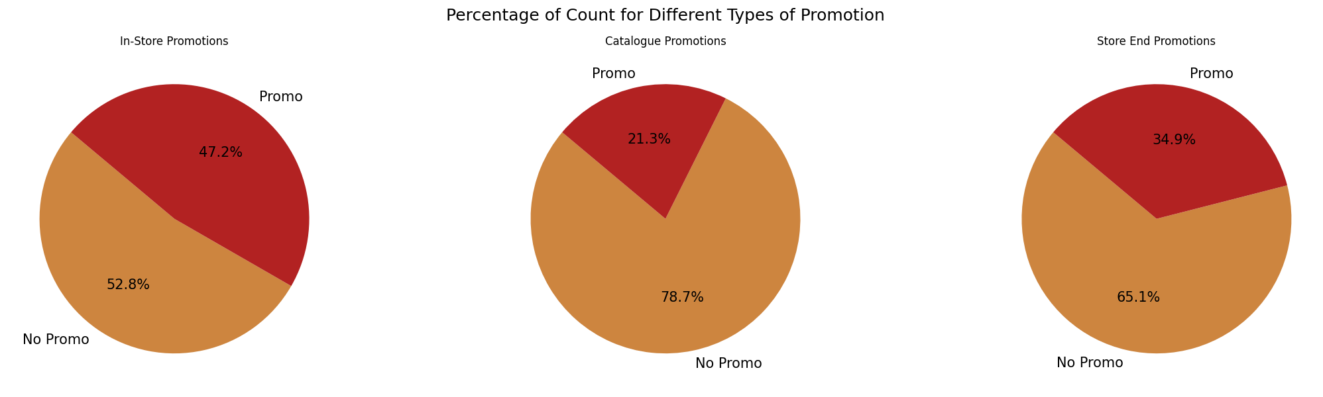
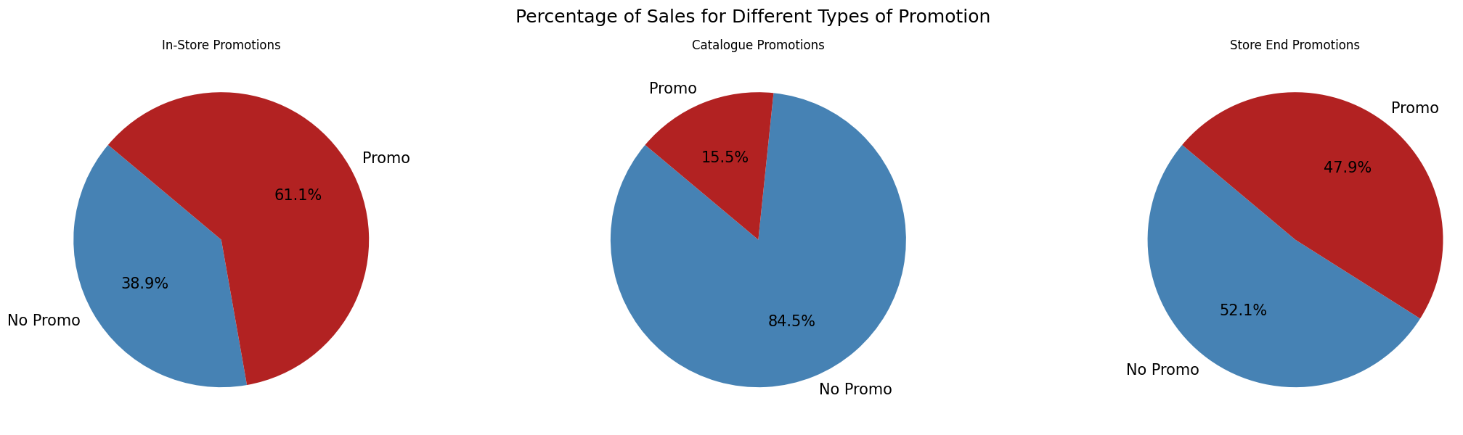
Promotion Analysis
In-Store Promotion:
Sales per promotion transaction are the high
Catalog Promotion:
Sales per promotion transaction are the lowest
Store-End Promotion:
Sales per promotion transaction are high

Slide 16
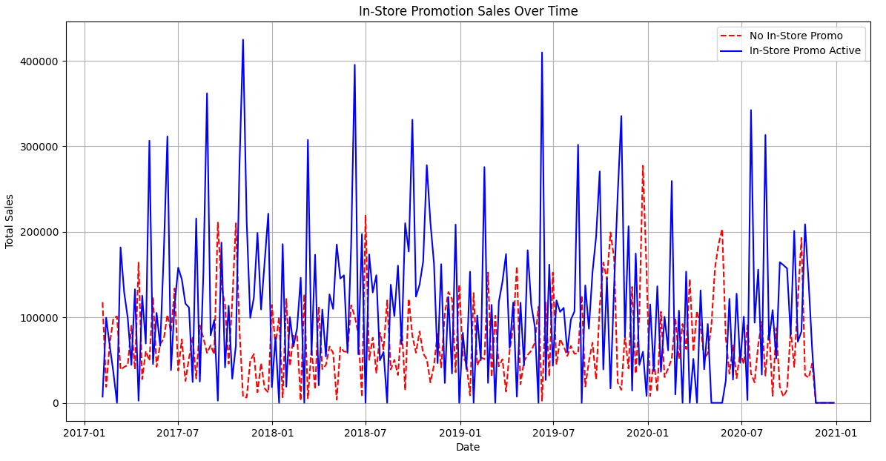
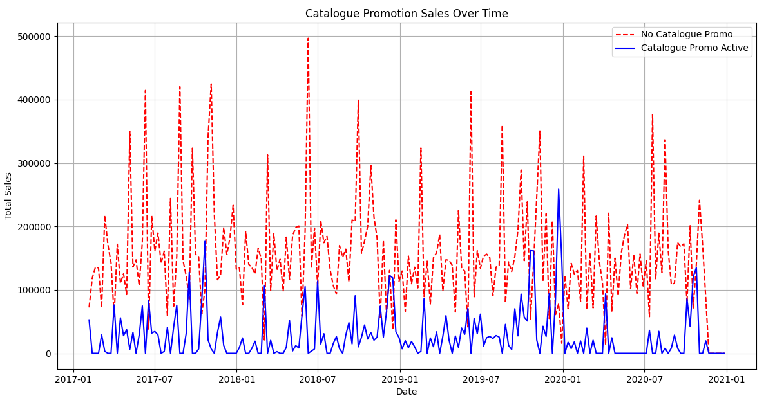
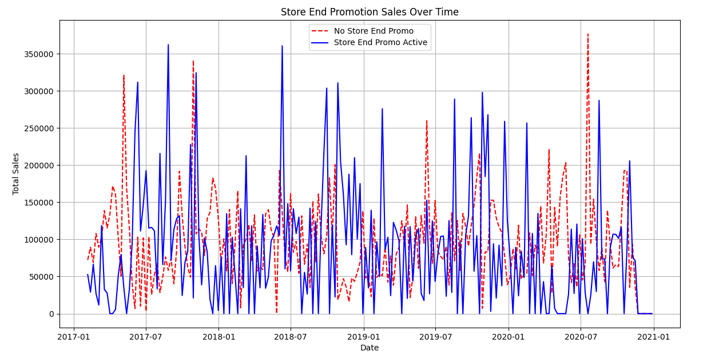
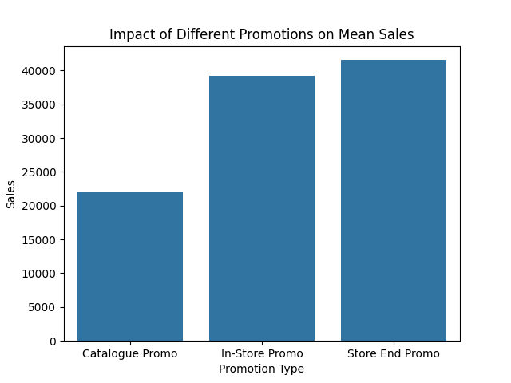
Promotion Analysis Over Time
The sales decreased significantly when catalog promotions were active, suggesting this promotion strategy might be ineffective and may lead to high cost.

Slide 17
Recommendation
Targeted Inventory Management: Align inventory levels with seasonal demand patterns, ensuring higher stock during peak sales periods like Q4 for SKU1 and SKU6, and Q3 for SKU3 and SKU4.
Refined Promotional Strategies: Given the indication that catalog promotions may be ineffective, consider reallocating marketing budgets to more effective promotion channels or redesigning the catalog strategy to better capture customer interest.
Diversified Product Strategy: For products like SKU2, which show decreased sales during certain holidays, develop strategies to diversify their appeal or bundle them with more popular items.
Enhanced Digital Presence: With physical store sales impacted by COVID-19, enhance the online shopping experience and digital presence to capture lost in-store sales and meet changing consumer behaviors.
Leverage Data for Forecasting: Use historical sales data to predict future trends and prepare for upcoming seasonal peaks and lows in demand.

Slide 18
Model Recommendations
ARIMA (AutoRegressive Integrated Moving Average)
Model that is well-suited for time series data with trends and seasonality.
Random Forest Regressor:
Ensemble model that can capture complex non-linear relationships.
Gradient Boosting Machines (GBM), e.g., XGBoost, LightGBM:
Boosting models that handle varied data types and distributions effectively.
Recurrent Neural Networks (RNNs), particularly LSTM (Long Short-Term Memory) or GRU (Gated Recurrent Units):
Deep learning models designed to work with sequential data, capturing time dependencies.

Slide 19
Thank You

